Slide 1

Data Visualization
Data Analytics Bootcamp
XBUS 400.04

Slide 2
Week 3, Friday, August 13, 2021 6:30 p.m. – 7:30 p.m.
Tableau installation
Introduction to Tableau
Connecting to data sources
Tableau user interface
Working with discrete and continuous data

Slide 3

Uses VizQL, a visual query language to convert drag-and-drop actions into data queries.
Offers 3 different annual subscription types — Creator, Explorer, and Viewer.
Creator subscription is $840 dollars a year and is only option available for individuals.
Companies can purchase Creator subscription for their employees, along with the two other subscription option— Explorer and Viewer.
Notes:
Companies can purchase Creator subscription for their employees, along with the two other subscription option— Explorer and Viewer. These subscriptions are between $243 to $522 annually and are intended for users who may not need access to Tableau Desktop and other advanced features.

Slide 4
Tableau Products
Tableau Desktop | Data visualization software you can download on your computer. It allows you to connect to a variety of data sources and create interactive visualizations and dashboards that can be shared with others.
Tableau Server | Enterprise-scale platform that allows businesses to securely manage employee access and how content created by their users with Tableau Desktop is published and distributed.
Tableau Online | A private cloud-based solution that allows users to securing share and distribute their visualizations and dashboards.
Tableau Public | A free service that allows users to create and publish their data visualizations. While the visualizations can be embedded into other webpages and shared via social media, you cannot save your work offline and the visualizations are automatically published and publicly available.
Tableau Reader | A free desktop application that allows users to view and interact with visualizations and dashboards built with Tableau Desktop. However, users cannot make any changes or edits to the visualizations.

Slide 5
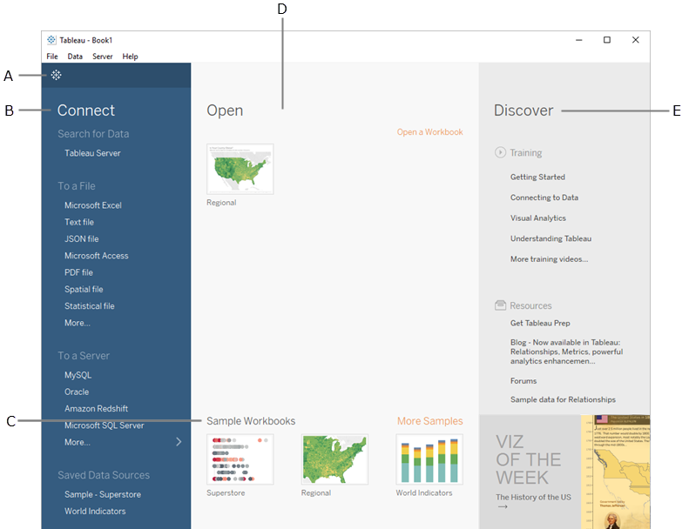
Start Page
Notes:
Tableau let’s you connect to data sources on your computer and to cloud-based applications
The Connect pane lists the most common data sources you might want to connect to

Slide 6
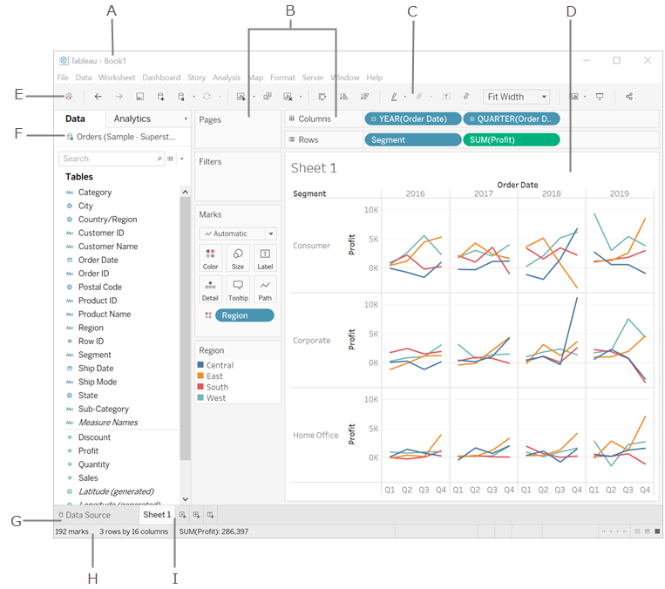
Tableau Workspace
Workbook name
Cards and Shelves
Toolbar
View
Go to the Start page
Side Bar
Go to the Data Source page
Status bar
Sheet tabs

Slide 7
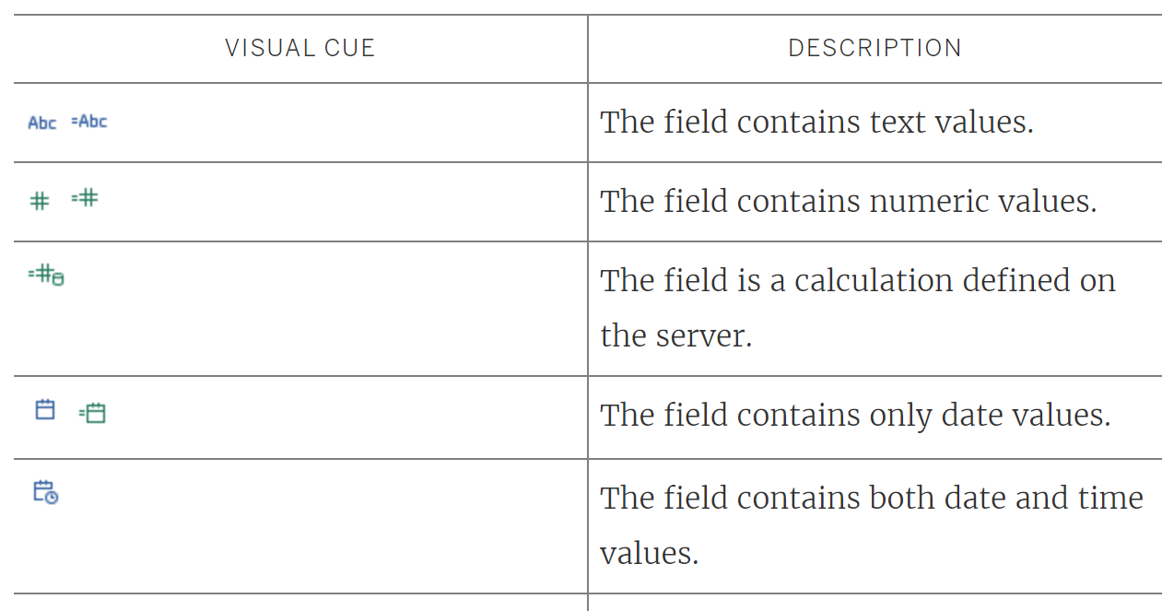
Visual Cues
Blue icon indicate that the field contains discrete data and are most often classified as Dimensions
Dimension are qualitative or categorical data, such as dates, names, or countries.
Green icons indicate that the field is continuous and are most often classified as Measures
Measures are quantitative numerical data and contain an infinite number of values, such as sales data or profit
An equal sign (=) indicates the column is a user-defined calculation or a copy of another field

